Slide 1
Biol 7200: Programming for Bioinformatics Implementing algorithms

Slide 2
Plan for today
What is an algorithm
Pseudocode
Simple algorithms
Implementing algorithms in Python
Needleman-Wunsch

Slide 3
Plan for today
What is an algorithm
Pseudocode
Simple algorithms
Implementing algorithms in Python
Needleman-Wunsch

Slide 4
Algorithms are sets of steps to achieve a result
Can very simple, very complex, or somewhere in between
Can describe any process
Choose an action (decision tree)
Select from a set of options
Modify a variable(s)
Perform a calculation

Slide 5
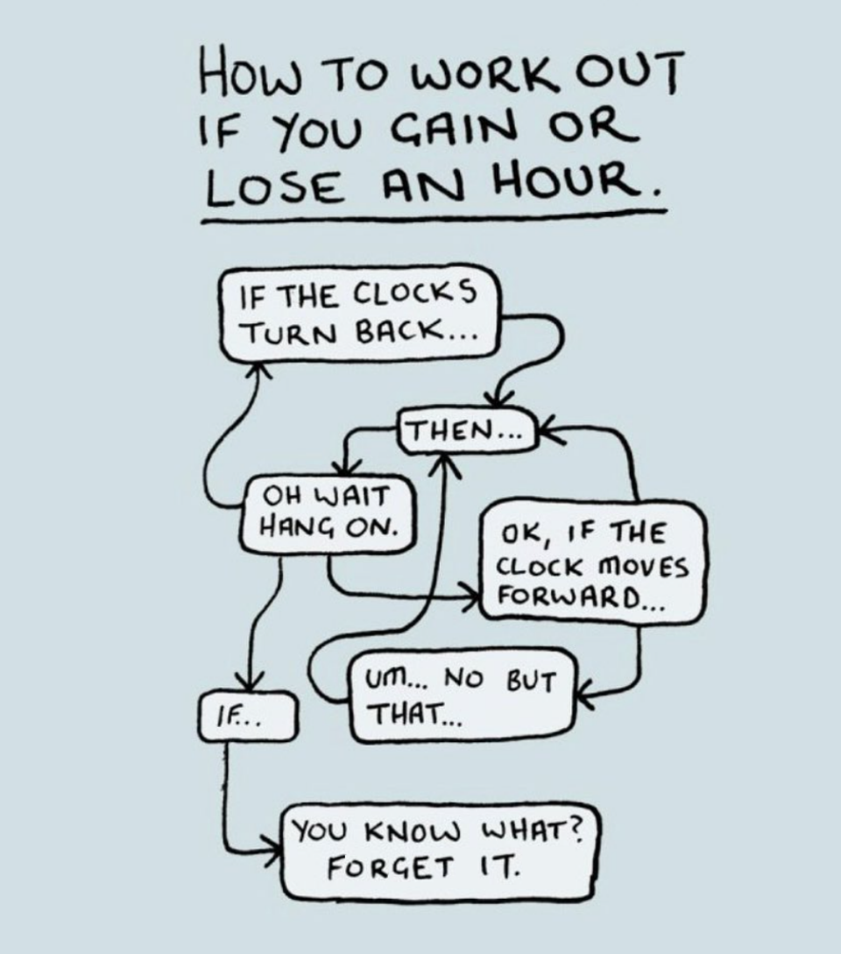
Algorithms can be expressed as flow charts
Adapted from: https://www.instagram.com/instachaaz/

Slide 6
Algorithms can be expressed as pseudocode
Algorithms can often be implemented using programming languages
Programming languages often provide clear statements of steps to perform
Pseudocode is a way of describing an algorithm using an approximation of a code implementation

Slide 7
Plan for today
What is an algorithm
Pseudocode
Simple algorithms
Implementing algorithms in Python
Needleman-Wunsch

Slide 8
How does one communicate how code works?
Pseudocode is essentially anything that attempts to describe a programmatic process without using actual code.
Can be English sentences or almost fully-formed code
No universal standard, but often similar to commonly used programming languages, such as C

Slide 9
A program to find the largest number in a list
Start with the number 0 as the largest number seen
Consider each element in the list, one by one. For each element
If the element is larger than the current largest, replace current largest
Otherwise do nothing
Proceed to the next number
Once all numbers are checked, the number stored is the largest

Slide 10
A program to find the largest number in a list
biggest = 0
for num in list do
if num > biggest then
biggest = num
return biggest
Python was designed so simple code would be as readable as pseudocode

Slide 11
Implementing pseudocode using python objects
biggest = 0
for num in list do
if num > biggest then
biggest = num
return biggest
biggest would be an int or float
The list of numbers would be an list (or tuple or set) of ints or floats
num would take an int or float value

Slide 12
Plan for today
What is an algorithm
Pseudocode
Simple algorithms
Implementing algorithms in Python
Needleman-Wunsch

Slide 13
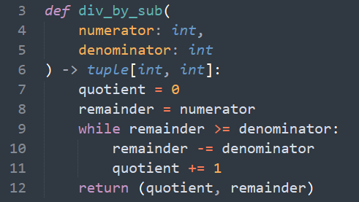
Algorithm for division – division by subtraction
Plain English: for a numerator, N and a denominator, D, count the number of times you can subtract D from N. When you can no longer subtract D, the remaining number is your remainder.”
Pseudocode:
Q = 0
While N >= D; do
N = N – D
Q = Q + 1
Return Q, N

Slide 14
Algorithm for multiplication – lattice multiplication
Lattice multiplication is a way to perform multiplication in your head or on paper
Mathematically equivalent to “long multiplication”
Easier to write out and do by hand
More fun to write in Python
How does it work? Let’s calculate 12 * 345

Slide 15
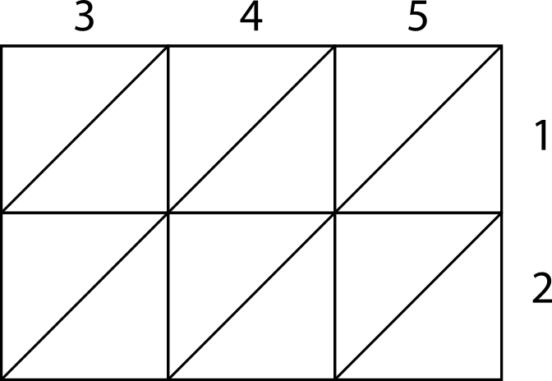
Step 1: make a matrix

Slide 16
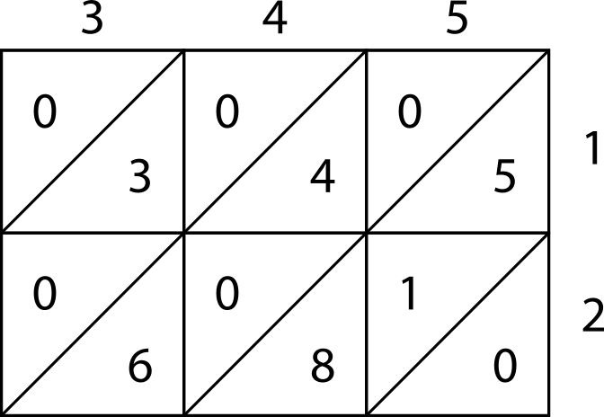
Step 2: multiply each digit

Slide 17
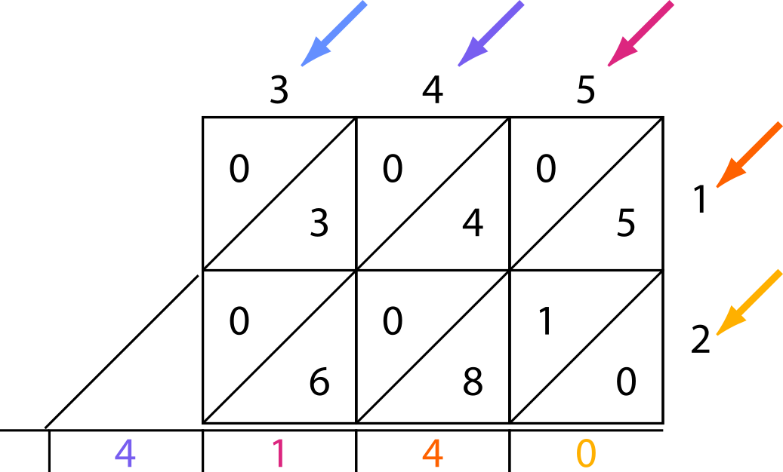
Step 3: Sum the diagonals and carry any 1s

Slide 18
Plan for today
What is an algorithm
Pseudocode
Simple algorithms
Implementing algorithms in Python
Needleman-Wunsch

Slide 19
Example of lattice multiplication posted on canvas
Jupyter notebook that goes step by step
Core data structure is the same as this week’s assignment

Slide 20
Plan for today
What is an algorithm
Pseudocode
Simple algorithms
Implementing algorithms in Python
Needleman-Wunsch

Slide 21
sequence alignment
Identification of positions that match between two sequences
Two types:
Global alignment (align all of two sequences)
Local alignment (identify subsequences that align)
Very commonly used in bioinformatics
E.g., BLAST – Basic Local Alignment Search Tool

Slide 22
Global vs local
Given two sequences:
TCACGTACTACGTGAT
GGACGTACTACTCGT
Possible global alignment
TCACGTACTACGTGAT
||||||||| | |
GGACGTACTAC-TCGT
Possible local alignment
ACGTACTAC
|||||||||
ACGTACTAC

Slide 23
Alignment scoring
When deciding between gaps, mismatches, and matches, generally matches are good
Mismatches and gaps are both worse than matches, but how much worse?
Are mismatches and gaps equally undesirable? If not, how much worse is one than the other?
This choice is hard, but impacts which is the best alignment greatly

Slide 24
Alignment scores determine which alignment is “best”
Consider two sequences: GACCTGCA and ACCAGCAT
Match: 1, mismatch: -1, gap: -1. Best alignment:
GACCTGCA-
||| |||
-ACCAGCAT
Match: 1, mismatch: -1, gap: -10. Best alignment:
GACCTGCA
|
ACCAGCAT
score = 6*match + 2*gap + 1*mismatch = 3
score = 1*match + 7*mismatch = -6
score of above =
6*match+2*gap+1*mismatch = -15

Slide 25
Needleman-Wunsch (NW) is a global alignment algorithm
Given two sequences, find the optimal alignment of the entire length
Uses scores to compare possible alignments
Scores can be simple (e.g., match = +1, mismatch = -1)
Scores can incorporate physical/chemical properties (e.g., BLOSUM, PAM matrices)
Uses a dynamic programming approach of matrix-filling and back-tracing to identify optimal alignments

Slide 26
Dynamic programming is an algorithm paradigm
Solve a hard problem by breaking it down into smaller, easier problems
Solve each small problem
Put the pieces back together
Often involves recursion

Slide 27
Dynamic programming in sequence alignment
Hard problem: what is the optimal alignment between two 1kb sequences?
Easier sub-problem: at some position in an alignment, what score (of goodness) would we assign to a gap vs no gap at the next position?
E.g.,
when aligning ATAG and CTTG
Imagine you’ve already aligned AT and CT
What comes next? Mismatch or gap?

Slide 28
Initialization: construct an matrix
Choose a scoring scheme, e.g.,:
Match = +1 Mismatch = -1 Gap = -1
Horizontal sequence
 |  | T | A | T | C | A | A | T
 | 0
T
A
G
T
C
A
T
Rules for filling out the matrix
A
B
Vertical sequence
+/- M
- G
C
- G
D
D is the cell to be filled, it takes the maximum of (A +/- Match/Mismatch), (B - Gap) & (C - Gap)

Slide 29
Initialization: fill top row and left column as gaps
-
-
 |  | T | A | T | C | A | A | T
 | 0 | -1 | -2 | -3 | -4
T
A
G
T
C
A
T
Match = +1
Mismatch = -1
Gap = -1
-3
- 1
-4
Remember which cell you just came from for later back-tracing

Slide 30
Initialization: fill top row and left column as gaps
-
-3
 |  | T | A | T | C | A | A | T
 | 0 | -1 | -2 | -3 | -4 | -5 | -6 | -7
T | -1
A | -2
G | -3
T | -4
C
A
T
- 1
Match = +1
Mismatch = -1
Gap = -1
-
-4

Slide 31
Matrix-filling: fill the matrix
0
-1
 |  | T | A | T | C | A | A | T
 | 0 | -1 | -2 | -3 | -4 | -5 | -6 | -7
T | -1 | 1
A | -2
G | -3
T | -4
C | -5
A | -6
T | -7
+ 1
- 1
Match = +1
Mismatch = -1
Gap = -1
-1
- 1
1
Each cell i,j is filled with greatest of:
Cell i-1,j + gap penalty
Cell i, j-1 + gap penalty
Cell i-1, j-1 + match bonus/ mismatch penalty

Slide 32
Matrix-filling: fill the matrix
-6
-7
 |  | T | A | T | C | A | A | T
 | 0 | -1 | -2 | -3 | -4 | -5 | -6 | -7
T | -1 | 1 | 0 | -1 | -2 | -3 | -4 | -5
A | -2
G | -3
T | -4
C | -5
A | -6
T | -7
+ 1
- 1
Match = +1
Mismatch = -1
Gap = -1
-4
- 1
-5
Sometimes there are equal scores when coming from different cells. Remember all equivalent sources

Slide 33
Matrix-filling: fill the matrix
2
1
 |  | T | A | T | C | A | A | T
 | 0 | -1 | -2 | -3 | -4 | -5 | -6 | -7
T | -1 | 1 | 0 | -1 | -2 | -3 | -4 | -5
A | -2 | 0 | 2 | 1 | 0 | -1 | -2 | -3
G | -3 | -1 | 1 | 1 | 0 | -1 | -2 | -3
T | -4 | -2 | 0 | 2 | 1 | 0 | -1 | -1
C | -5 | -3 | -1 | 1 | 3 | 2 | 1 | 0
A | -6 | -4 | -2 | 0 | 2 | 4 | 3
T | -7
+ 1
- 1
Match = +1
Mismatch = -1
Gap = -1
4
- 1
3
Sometimes there are equal scores when coming from different cells. Remember all equivalent sources

Slide 34
Matrix-filling: fill the matrix
 |  | T | A | T | C | A | A | T
 | 0 | -1 | -2 | -3 | -4 | -5 | -6 | -7
T | -1 | 1 | 0 | -1 | -2 | -3 | -4 | -5
A | -2 | 0 | 2 | 1 | 0 | -1 | -2 | -3
G | -3 | -1 | 1 | 1 | 0 | -1 | -2 | -3
T | -4 | -2 | 0 | 2 | 1 | 0 | -1 | -1
C | -5 | -3 | -1 | 1 | 3 | 2 | 1 | 0
A | -6 | -4 | -2 | 0 | 2 | 4 | 3 | 2
T | -7 | -5 | -3 | -1 | 1 | 3 | 3 | 4
Match = +1
Mismatch = -1
Gap = -1

Slide 35
Back-tracing: Follow the arrows back
 |  | T | A | T | C | A | A | T
 | 0 | -1 | -2 | -3 | -4 | -5 | -6 | -7
T | -1 | 1 | 0 | -1 | -2 | -3 | -4 | -5
A | -2 | 0 | 2 | 1 | 0 | -1 | -2 | -3
G | -3 | -1 | 1 | 1 | 0 | -1 | -2 | -3
T | -4 | -2 | 0 | 2 | 1 | 0 | -1 | -1
C | -5 | -3 | -1 | 1 | 3 | 2 | 1 | 0
A | -6 | -4 | -2 | 0 | 2 | 4 | 3 | 2
T | -7 | -5 | -3 | -1 | 1 | 3 | 3 | 4
Starting in the bottom right cell, follow the arrows back to the top left cell

Slide 36
Back-tracing: Follow the arrows back
3
2
 |  | T | A | T | C | A | A | T
 | 0 | -1 | -2 | -3 | -4 | -5 | -6 | -7
T | -1 | 1 | 0 | -1 | -2 | -3 | -4 | -5
A | -2 | 0 | 2 | 1 | 0 | -1 | -2 | -3
G | -3 | -1 | 1 | 1 | 0 | -1 | -2 | -3
T | -4 | -2 | 0 | 2 | 1 | 0 | -1 | -1
C | -5 | -3 | -1 | 1 | 3 | 2 | 1 | 0
A | -6 | -4 | -2 | 0 | 2 | 4 | 3 | 2
T | -7 | -5 | -3 | -1 | 1 | 3 | 3 | 4
Choose cell with an arrow to move to.
3
4

Slide 37
Back-tracing: Follow the arrows back
3
2
 |  | T | A | T | C | A | A | T
 | 0 | -1 | -2 | -3 | -4 | -5 | -6 | -7
T | -1 | 1 | 0 | -1 | -2 | -3 | -4 | -5
A | -2 | 0 | 2 | 1 | 0 | -1 | -2 | -3
G | -3 | -1 | 1 | 1 | 0 | -1 | -2 | -3
T | -4 | -2 | 0 | 2 | 1 | 0 | -1 | -1
C | -5 | -3 | -1 | 1 | 3 | 2 | 1 | 0
A | -6 | -4 | -2 | 0 | 2 | 4 | 3 | 2
T | -7 | -5 | -3 | -1 | 1 | 3 | 3 | 4
Choose cell with an arrow to move to.
3
4

Slide 38
Back-tracing: Follow the arrows back
2
1
 |  | T | A | T | C | A | A | T
 | 0 | -1 | -2 | -3 | -4 | -5 | -6 | -7
T | -1 | 1 | 0 | -1 | -2 | -3 | -4 | -5
A | -2 | 0 | 2 | 1 | 0 | -1 | -2 | -3
G | -3 | -1 | 1 | 1 | 0 | -1 | -2 | -3
T | -4 | -2 | 0 | 2 | 1 | 0 | -1 | -1
C | -5 | -3 | -1 | 1 | 3 | 2 | 1 | 0
A | -6 | -4 | -2 | 0 | 2 | 4 | 3 | 2
T | -7 | -5 | -3 | -1 | 1 | 3 | 3 | 4
Choose cell with an arrow to move to.
multiple arrows indicate alternative alignment solutions
For the homework, we won’t require you find all equally good alignments, so you can just tie-break: e.g., prefer diagonal
Unless you want a challenge…
4
3

Slide 39
Back-tracing: Follow the arrows back
2
1
 |  | T | A | T | C | A | A | T
 | 0 | -1 | -2 | -3 | -4 | -5 | -6 | -7
T | -1 | 1 | 0 | -1 | -2 | -3 | -4 | -5
A | -2 | 0 | 2 | 1 | 0 | -1 | -2 | -3
G | -3 | -1 | 1 | 1 | 0 | -1 | -2 | -3
T | -4 | -2 | 0 | 2 | 1 | 0 | -1 | -1
C | -5 | -3 | -1 | 1 | 3 | 2 | 1 | 0
A | -6 | -4 | -2 | 0 | 2 | 4 | 3 | 2
T | -7 | -5 | -3 | -1 | 1 | 3 | 3 | 4
4
3

Slide 40
Back-tracing: Follow the arrows back
2
1
 |  | T | A | T | C | A | A | T
 | 0 | -1 | -2 | -3 | -4 | -5 | -6 | -7
T | -1 | 1 | 0 | -1 | -2 | -3 | -4 | -5
A | -2 | 0 | 2 | 1 | 0 | -1 | -2 | -3
G | -3 | -1 | 1 | 1 | 0 | -1 | -2 | -3
T | -4 | -2 | 0 | 2 | 1 | 0 | -1 | -1
C | -5 | -3 | -1 | 1 | 3 | 2 | 1 | 0
A | -6 | -4 | -2 | 0 | 2 | 4 | 3 | 2
T | -7 | -5 | -3 | -1 | 1 | 3 | 3 | 4
After each step store the base from each sequence. Store base after move. E.g., on this slide we’ve stored 2 bases as we’ve moved twice.
Diagonal move means store both bases
Vertical move means store gap in horizontal sequence
Horizontal move means store gap in vertical sequence
4
3
Horizontal
Vertical
TA
TA

Slide 41
Back-tracing: Follow the arrows back
1
0
 |  | T | A | T | C | A | A | T
 | 0 | -1 | -2 | -3 | -4 | -5 | -6 | -7
T | -1 | 1 | 0 | -1 | -2 | -3 | -4 | -5
A | -2 | 0 | 2 | 1 | 0 | -1 | -2 | -3
G | -3 | -1 | 1 | 1 | 0 | -1 | -2 | -3
T | -4 | -2 | 0 | 2 | 1 | 0 | -1 | -1
C | -5 | -3 | -1 | 1 | 3 | 2 | 1 | 0
A | -6 | -4 | -2 | 0 | 2 | 4 | 3 | 2
T | -7 | -5 | -3 | -1 | 1 | 3 | 3 | 4
After each step store the base from each sequence. Store base after move. E.g., on this slide we’ve stored 2 bases as we’ve moved twice.
Diagonal move means store both bases
Vertical move means store gap in horizontal sequence
Horizontal move means store gap in vertical sequence
3
2
Horizontal
Vertical
TA
TA

Slide 42
Back-tracing: Follow the arrows back
1
0
 |  | T | A | T | C | A | A | T
 | 0 | -1 | -2 | -3 | -4 | -5 | -6 | -7
T | -1 | 1 | 0 | -1 | -2 | -3 | -4 | -5
A | -2 | 0 | 2 | 1 | 0 | -1 | -2 | -3
G | -3 | -1 | 1 | 1 | 0 | -1 | -2 | -3
T | -4 | -2 | 0 | 2 | 1 | 0 | -1 | -1
C | -5 | -3 | -1 | 1 | 3 | 2 | 1 | 0
A | -6 | -4 | -2 | 0 | 2 | 4 | 3 | 2
T | -7 | -5 | -3 | -1 | 1 | 3 | 3 | 4
After each step store the base from each sequence. Store base after move. E.g., on this slide we’ve stored 2 bases as we’ve moved twice.
Diagonal move means store both bases
Vertical move means store gap in horizontal sequence
Horizontal move means store gap in vertical sequence
3
2
Horizontal
Vertical
TAA
TA-

Slide 43
Back-tracing: Follow the arrows back
 |  | T | A | T | C | A | A | T
 | 0 | -1 | -2 | -3 | -4 | -5 | -6 | -7
T | -1 | 1 | 0 | -1 | -2 | -3 | -4 | -5
A | -2 | 0 | 2 | 1 | 0 | -1 | -2 | -3
G | -3 | -1 | 1 | 1 | 0 | -1 | -2 | -3
T | -4 | -2 | 0 | 2 | 1 | 0 | -1 | -1
C | -5 | -3 | -1 | 1 | 3 | 2 | 1 | 0
A | -6 | -4 | -2 | 0 | 2 | 4 | 3 | 2
T | -7 | -5 | -3 | -1 | 1 | 3 | 3 | 4
After each step store the base from each sequence. Store base after move. E.g., on this slide we’ve stored 2 bases as we’ve moved twice.
Diagonal move means store both bases
Vertical move means store gap in horizontal sequence
Horizontal move means store gap in vertical sequence
Horizontal
Vertical
TAACT-AT
TA-CTGAT

Slide 44
Finishing: reverse the sequences
 |  | T | A | T | C | A | A | T
 | 0 | -1 | -2 | -3 | -4 | -5 | -6 | -7
T | -1 | 1 | 0 | -1 | -2 | -3 | -4 | -5
A | -2 | 0 | 2 | 1 | 0 | -1 | -2 | -3
G | -3 | -1 | 1 | 1 | 0 | -1 | -2 | -3
T | -4 | -2 | 0 | 2 | 1 | 0 | -1 | -1
C | -5 | -3 | -1 | 1 | 3 | 2 | 1 | 0
A | -6 | -4 | -2 | 0 | 2 | 4 | 3 | 2
T | -7 | -5 | -3 | -1 | 1 | 3 | 3 | 4
Horizontal
Vertical
TAACT-AT -> TA-TCAAT
TA-CTGAT -> TAGTC-AT

Slide 45
Finishing: alignment score
 |  | T | A | T | C | A | A | T
 | 0 | -1 | -2 | -3 | -4 | -5 | -6 | -7
T | -1 | 1 | 0 | -1 | -2 | -3 | -4 | -5
A | -2 | 0 | 2 | 1 | 0 | -1 | -2 | -3
G | -3 | -1 | 1 | 1 | 0 | -1 | -2 | -3
T | -4 | -2 | 0 | 2 | 1 | 0 | -1 | -1
C | -5 | -3 | -1 | 1 | 3 | 2 | 1 | 0
A | -6 | -4 | -2 | 0 | 2 | 4 | 3 | 2
T | -7 | -5 | -3 | -1 | 1 | 3 | 3 | 4
Match = +1
Mismatch = -1
Gap = -1
Horizontal
Vertical
Score
TAACT-AT -> TA-TCAAT
TA-CTGAT -> TAGTC-AT
6*match + 2*gap = 4

Slide 46
Finishing: alignment score
 |  | T | A | T | C | A | A | T
 | 0 | -1 | -2 | -3 | -4 | -5 | -6 | -7
T | -1 | 1 | 0 | -1 | -2 | -3 | -4 | -5
A | -2 | 0 | 2 | 1 | 0 | -1 | -2 | -3
G | -3 | -1 | 1 | 1 | 0 | -1 | -2 | -3
T | -4 | -2 | 0 | 2 | 1 | 0 | -1 | -1
C | -5 | -3 | -1 | 1 | 3 | 2 | 1 | 0
A | -6 | -4 | -2 | 0 | 2 | 4 | 3 | 2
T | -7 | -5 | -3 | -1 | 1 | 3 | 3 | 4
Optimal alignment score is always equal to bottom right cell value
Match = +1
Mismatch = -1
Gap = -1
Horizontal
Vertical
Score
TAACT-AT -> TA-TCAAT
TA-CTGAT -> TAGTC-AT
6*match + 2*gap = 4

Slide 47
More complicated: alternative alignments
 |  | T | A | T | C | A | A | T
 | 0 | -1 | -2 | -3 | -4 | -5 | -6 | -7
T | -1 | 1 | 0 | -1 | -2 | -3 | -4 | -5
A | -2 | 0 | 2 | 1 | 0 | -1 | -2 | -3
G | -3 | -1 | 1 | 1 | 0 | -1 | -2 | -3
T | -4 | -2 | 0 | 2 | 1 | 0 | -1 | -1
C | -5 | -3 | -1 | 1 | 3 | 2 | 1 | 0
A | -6 | -4 | -2 | 0 | 2 | 4 | 3 | 2
T | -7 | -5 | -3 | -1 | 1 | 3 | 3 | 4
To get all alternative alignments, you need to write a function that can be branched. E.g., a function that calls itself recursively.
Outside the scope of this class, but we can discuss in a review session.
TA-TCAAT TA-TCAAT
TAGTC-AT TAGTCA-T

Slide 48
Helpful resource to familiarize yourself
https://bioboot.github.io/bimm143_F23/class-material/nw/
Excellent web-based javascript application to interactively explore the Needleman-Wunsch algorithm written by Barry Grant at UCSD

Slide 49
End of Lesson

